Slide 1
University Project
Project Review – 1
Under the Supervision
of
Mrs. S.Sridevi
Assistant Professor
School of Computer Science & Engineering
Presidency University
Roll Number Student Name
20201CIT0026 S.GIRISH
20201CIT0036 CHANDANA.S
20201CIT0032 SHASHANK.A
20201CIT0034 DHANRAJ.N
20201CIT0007 SHREE VISHNU

Slide 2
TITLE : CRASH ALERT PRO

Slide 3
Abstract
"Vehicle fall detection with Arduino, IoT, and GPS is a life-saving system. It uses sensors to spot falls or accidents in a vehicle. When it detects an incident, it sends real-time alerts with the vehicle's location to a central system. This helps get help quickly, even in remote areas, making vehicles safer."

Slide 4
Literature Review
1. TITLE: Accident Prevention And Identification System For Vehicles Using Arduino
AUTHOR: R. LAVANYA, S. BALAMURUGAN
YEAR: 2022
DESCRIPTION:. The global auto industry is growing steadily, which means more people will own cars. While safety features in vehicles have improved, post-accident reporting needs a boost. Accidents happen, but lives can be saved with timely data for emergency services. Our model offers a solution. It also helps prevent accidents caused by reckless driving and speeding. The system monitors speed, warns the driver, and alerts concerned parties if the driver doesn't respond. More vehicles on the road lead to more accidents, causing delays for ambulances and hospitals. Quick hospital trips are crucial. After an accident, reporting to investigators and research departments should be swift to minimize research time.
DISADVANTAGE:
The systems compatibility with different vehicle makes and models may be limited. Customization and adaptation for various vehicles may require additional time and effort, making it less accessible for a wide range of users.

Slide 5
Literature Review
2. TITLE: Accident Detection and Notification System using GPS and GSM navigation technology
AUTHOR: Dilkhush, Nikhil Pal, Kedar Nath Parida
YEAR: 2020
DESCRIPTION:. Accidents are on the rise due to increased vehicle usage, often caused by over speeding. There's a growing demand for anti-accident systems as people seek better vehicle performance. Accidents happen due to high speed, drunk driving, distractions, stress, and gadgets. Our project addresses accidents caused by driver carelessness. We've created a system to detect accidents and notify the driver. If the driver loses control, the system sends alerts to registered mobile numbers. This GPS and GSM-based system aims to save lives by quickly reporting accidents to hospitals and vehicle owners..
DISADVANTAGE:
In the systems may have limited data transmission capacity, which could restrict the amount of information that can be sent in an accident notification. This limitation may impact the comprehensiveness of the alerts and the details provided to emergency services.

Slide 6
Literature Review
3. TITLE: Accident Detection And Alerting System
AUTHOR: P.G. KATE, S.T. SHINDE
YEAR: 2019
DESCRIPTION: Transportation is essential but accidents are a growing concern. To address this, we've created an Accident Detection and Messaging System using GPS and GSM. It uses a vibration sensor monitored by Arduino. When an accident happens, the sensor triggers actions. It sends an SMS to authorities for immediate help. This system is promising and aims to save lives. Despite efforts to promote safe driving, accidents continue. Quick and automatic accident detection with location notification to emergency services is crucial to save lives.
DISADVANTAGE:
The cost of implementing and maintaining a GPS-based accident detection system can be relatively high. This includes the cost of GPS hardware, data plans for real-time tracking, and maintenance expenses.

Slide 7
Literature Review
4. TITLE: An Automatic Vehicle Accident Detection and Rescue System
AUTHOR: Tafadzwa Petros Chikaka ,Omowunmi Mary Longe
YEAR: 2021
DESCRIPTION: Road accidents cause human loss and hinder socio-economic progress, especially in developing countries. Quick reporting to emergency services is crucial, and delays due to heavy traffic can be life-threatening. We've developed an automatic accident detection and alert system using accelerometers. It detects accidents and sends GPS location to security, medical, and family contacts. Our system responds faster than traditional methods, saving more lives with technology.
DISADVANTAGE:
It can be complex and may require professional assistance. This complexity can increase the cost of implementing the system.

Slide 8
Literature Review
5. TITLE: Accident Detection And Tracking System Using GSM, GPS And Arduino
AUTHOR: CH. Gowri, B. Raj Kumar
YEAR: 2020
DESCRIPTION: Technology has improved our lives but also brought more traffic and accidents. This project automatically detects accidents and alerts emergency services. It uses sensors like accelerometer, vibration sensor, and ultrasonic sensor. GPS and GSM send the accident location to mobile devices. This helps emergency services respond quickly and saves lives.
DISADVANTAGE:
The system can involve significant costs, including the purchase of hardware, data plans, and installation. This cost may be a disadvantage for individuals or organizations with limited budgets.

Slide 9
Objectives
Real-time Safety Monitoring: Create a system capable of continuously monitoring the movement and orientation of vehicles to detect sudden falls or rollovers, thereby enhancing the safety of vehicle occupants.
Accurate Location Tracking: Integrate GPS technology to provide precise and real-time location data, enabling immediate response and assistance in the event of an accident.
IoT Connectivity: Establish a seamless IoT network for the automatic transmission of critical accident information to a central server, ensuring rapid alert dissemination to relevant authorities and emergency responders.
Alert System: Develop an automated alert system that triggers notifications, including vehicle location, time of the incident, and other relevant data, to inform authorities and emergency services about accidents as they occur.

Slide 10
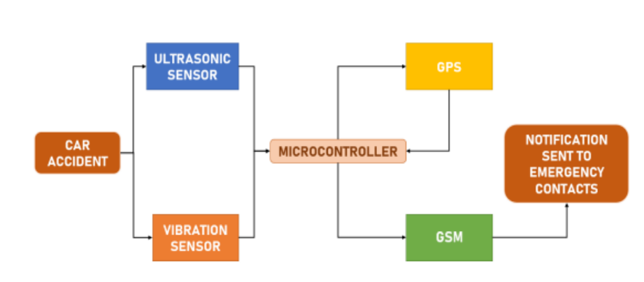
Existing System
In the existing system is Street car accidents are a major public health concern because they result in significant loss of life, property, and time. Many lives will be saved if clinical assistance is provided quickly. This paper describes a smart mishap detection and warning system that sends a message to the user's emergency contacts when a mishap occurs, along with the detected location. When the vehicle is involved in an accident, the vehicle's sensor detects it immediately and sends an SMS to the crisis contacts. In the case that everyone within the car is safe, a reset button can be used to prevent the alert from being broadcast to the crisis contacts. The proposed system follows the methodology as follows: A vibration sensor is utilized to quantify the vibration prompted by the vehicle’s crash. An ultrasonic sensor will recognize the presence of an individual inside the vehicle. The whole system won’t be set off if the sensor doesn’t detect the presence of an individual.
A micro-controller that reads the vibration frequencies will set the GPS module to get the mishap’s coordinates. The GPS component gives the coordinates to the micro-controller, which uses the GSM module to transmit the coordinates to the emergency contacts by SMS as a Google Maps URL.
BLOCK DIAGRAM

Slide 11
Drawbacks of Existing System
In areas with poor or no network coverage, the system may not function correctly, leading to delays in reporting accidents or rendering the system useless.
These systems can alert emergency services quickly, the effectiveness of the response depends on the availability and proximity of emergency services. In remote or rural areas, response times may still be lengthy.

Slide 12
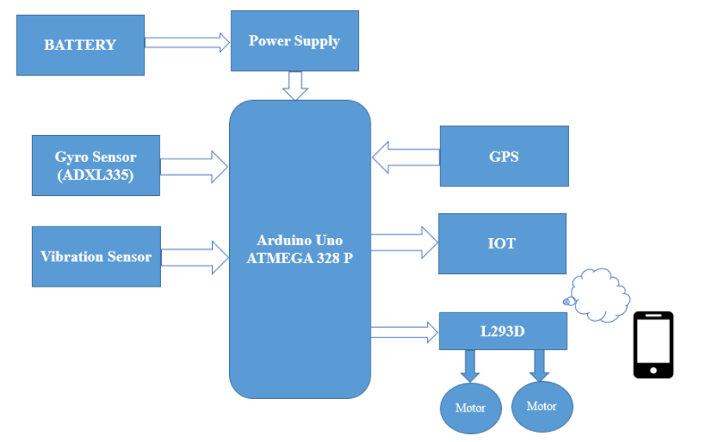
Proposed System
In this proposed system, a Vehicle Fall Detection System (VFDS), incorporates cutting-edge technology to enhance road safety and improve response times during vehicular accidents. This system combines an Arduino-based hardware platform with the integration of a Gyro Sensor (ADXL335), vibration sensor, GPS technology, and the Internet of Things (IoT) to provide a comprehensive solution. The Gyro Sensor and vibration sensor work in tandem to monitor the vehicles movement and detect sudden falls or rollovers, enabling real-time assessment of potential accidents. The GPS module is employed to provide accurate location data, ensuring that the vehicles precise coordinates are known at all times. The IoT network forms the backbone of our system, facilitating the seamless transmission of critical accident information to a central server, accessible to relevant authorities and emergency responders.
In the event of a fall or rollover, the system triggers an automatic alert that includes the vehicles location and relevant data, allowing for immediate response. The integrating these technologies, the vehicle fall detection system aims to significantly enhance vehicle safety, reduce accident severity, and expedite response times, ultimately contributing to a safer and more efficient transportation ecosystem.

Slide 13
Architecture Diagram

Slide 14
Methodology
In this proposed system, a Vehicle Fall Detection System (VFDS), incorporates cutting-edge technology to enhance road safety and improve response times during vehicular accidents. This system combines an Arduino-based hardware platform with the integration of a Gyro Sensor (ADXL335), vibration sensor, GPS technology, and the Internet of Things (IoT) to provide a comprehensive solution. The Gyro Sensor and vibration sensor work in tandem to monitor the vehicles movement and detect sudden falls or rollovers, enabling real-time assessment of potential accidents. The GPS module is employed to provide accurate location data, ensuring that the vehicles precise coordinates are known at all times. The IoT network forms the backbone of our system, facilitating the seamless transmission of critical accident information to a central server, accessible to relevant authorities and emergency responders. In the event of a fall or rollover, the system triggers an automatic alert that includes the vehicles location and relevant data, allowing for immediate response. The integrating these technologies, the vehicle fall detection system aims to significantly enhance vehicle safety, reduce accident severity, and expedite response times, ultimately contributing to a safer and more efficient transportation ecosystem.

Slide 15
Modules
SENSORS UNIT
Accelerometer Sensor: Connect the accelerometer to the microcontroller's analog pins. It typically requires power (VCC), ground (GND), and data (OUT) connections.
Vibration Sensor: Connect the vibration sensor to digital pins on the microcontroller. It usually has power (VCC), ground (GND), and an output signal (OUT).
GPS Sensor: Connect the GPS sensor to the microcontroller using suitable communication interfaces like UART or I2C. It requires power (VCC), ground (GND), and communication pins (TX, RX).
MICROCONTROLLER UNIT (ATMEGA328P)
The brain of the system, responsible for processing sensor data and making decisions.
Connect power (VCC) and ground (GND) pins of the microcontroller to the appropriate power supply.
Connect the accelerometer and vibration sensors to analog or digital pins, based on their specifications.
Connect the GPS sensor to the microcontroller's communication pins (TX, RX) for data exchange.

Slide 16
Modules
IOT UNIT
IoT Module (e.g., ESP8266 or similar): Facilitates communication with the IoT platform.
Connect the IoT module to the microcontroller using a suitable communication protocol (e.g., UART, SPI, etc.).
Provide power (VCC) and ground (GND) to the IoT module.
Implement any necessary level shifting or voltage regulation, if required.
VEHICLE MODEL UNIT
L293D Driver Board: Used for driving DC motors.
DC Motor: The actuators that might perform specific actions (e.g., deploy airbags, trigger alarms, etc.).
Connect the L293D driver board to the microcontroller. Wire the input pins to the microcontroller's output pins, and connect power (VCC) and ground (GND).
Connect the DC motor to the output pins of the L293D driver board. Ensure proper power supply and polarity.

Slide 17
HARDWARE AND SOFTWARE REQUIREMENTS
HARDWARE DETAILS
Battery
Power Supply Unit
Atmega328p Microcontroller
Gyro Sensor (Adxl335)
Vibration Sensor
GPS
Nodemcu
Driver Board
Dc Motor
SOFTWARE REQUIREMENT
Programming Language - Embedded C
Compiler - ARDUINO IDE 1.8.19
Simulation - PROTEUS

Slide 18
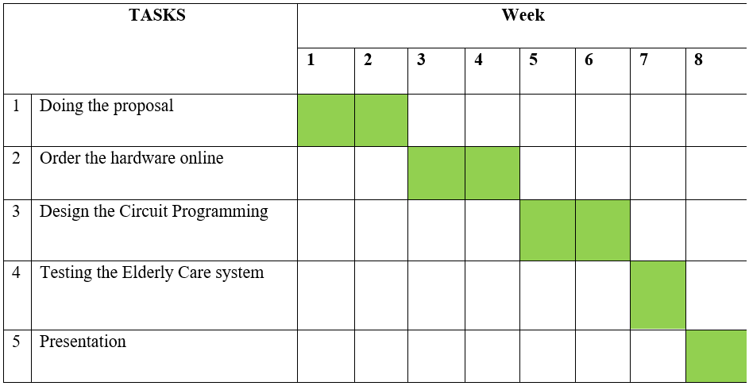
TIME LINE GANTT CHART

Slide 19
References
Rohit Ganiga, Rohit Maurya, Archana Nanade,”Accident detection system using Piezo Disk Sensor”, International Journel of science, Engineering and Technology Research(IJSETR) volume6,Issue3,March 2017,ISSN 2278-7798
Nimisha Chaturvedi, PallikaSrivastava . “Automatic Vehicle Accident Detection and Messaging System Using GSM and GPS Modem “,Volume: 05 Issue: 03 | Mar-2018.
J. (2020, October 31). How to Interface GSM Module to Arduino-Send and Receive SMS. Electronic Circuits and Diagrams-Electronic Projects and Design.
S. Sharma and S. Sebastian, "IoT based car accident detection and notification algorithm for general road accidents", International Journal of Electrical & Computer Engineering, vol. 9, no. 5, pp. 2088-8708, 2019.
N. Kattukkaran, A. George and T. M. Haridas, "Intelligent accident detection and alert system for emergency medical assistance", 2017 International Conference on Computer Communication and Informatics (ICCCI), pp. 1-6, 2017, January.
M. Murshed and M. S. Chowdhury, "An IoT based car accident prevention and detection system with smart brake control", Proc. Int. Conf. Appl. Techn. Inf. Sci.(iCATIS), pp. 23, 2019, January.

Slide 20
Thank You

